Slide 1
Presentation by PV Rao, Director, Pennar Industries
On
Pre-Engineered Buildings – Merits and de-merits over Conventional buildings and Long spans achievement

Slide 2
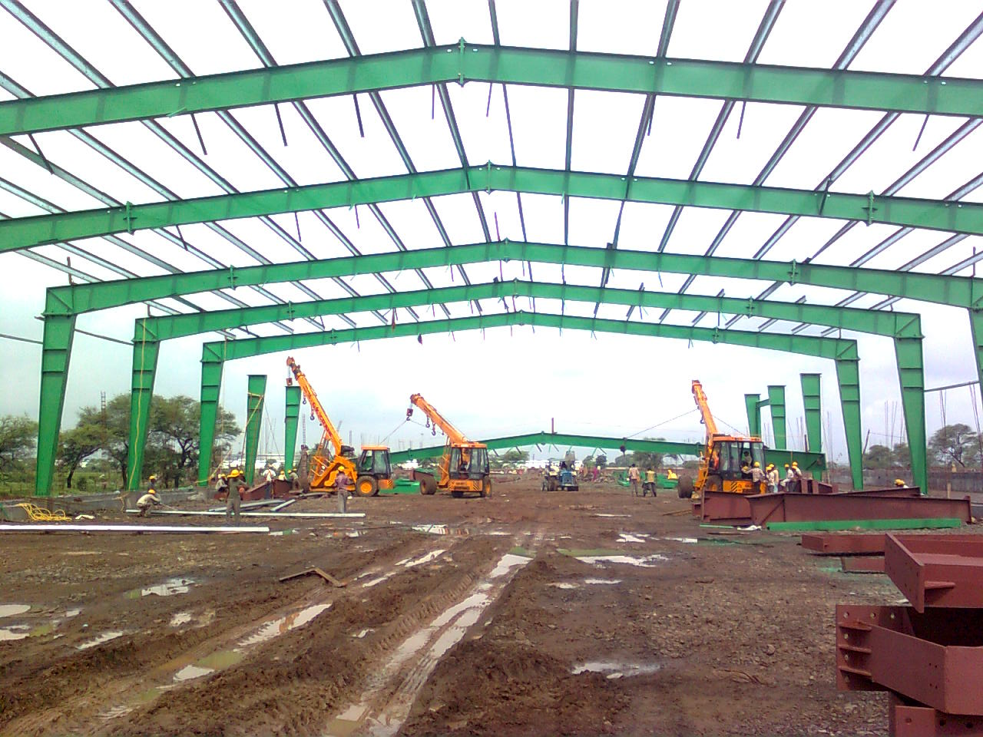
EVOLUTION OF PEB CONCEPT
EARLY 1900’S
Concept of Metal Buildings originated in U.S.A
“Prefabricated Metal Buildings” named in early mid nineteenth century
Simple Industrial structures using sectional roofs & wall wedges pins for connections
Concept of “Portable Iron Houses” started to satisfy housing needs of California during Gold Rush.
Steel became alternative to other building materials.
In 1923, American Institute of Steel Construction (AISC) was formed - Standard specification for Design ,Fabrication and Erection were initiated.

Slide 3
EVOLUTION OF PEB CONCEPT
EARLY 1940’S
WORLD WAR –II
Re-locatable Barracks - These shelters are readily dismantled, moved and re-erected.
Aircraft hangars used by U.S army were built using PEB concept.
Mass production of housing and storage modules for U.S army.
Economic Boom.
Started building factories with PEB concept to meet the huge demand for consumer products.
Metal building system was preferred as a favorable method of construction over conventional methods.
POST WORLD WAR-II

Slide 4
EVOLUTION OF PEB CONCEPT
LATE 1950’S & EARLY 1960’S
Computerized design possibilities became limitless.
Started making Buildings to suit individual customer requirements.
Roll forming lines used to form cold rolled Z&C- purlins.
Color coated panels and factory insulated panels improved architectural appearance.
Major increase in design possibilities contributed to the boom in metal buildings.

Slide 5
EVOLUTION OF PEB CONCEPT
POST 1980’S
Pre Engineered Buildings dominated the low rise non residential buildings market in U S, Europe & Middle East.
Auto production lines came into existence for primary & secondary members
High quality paint systems for steel and cladding.
In USA, MBMA statistics show about 60% of low rise industrial and commercial buildings are pre engineered buildings.

Slide 6
ASSOCIATIONS RELATED TO PEB
MBMA (Metal building Manufacturers Association)
AISI (American Iron and Steel Institute)
MBCEA (Metal Building Contractors & Erectors Association)
NAIMA (North American Insulation Manufacturers Association)
MCA (Metal Construction Association)
NRCA (National Roofing Contractors Association )
LGSI (Light Gage Structural Institute)
CCFSS (Center For Cold – Formed Steel Structures )

Slide 7
PEB CONCEPT IN INDIA
PEB entered Indian markets in the late 1990’s
FDI inflow accelerated PEB acceptance and usage in early 2000’s
Currently the industry is growing at the rate of 12 to 15 % per year
Revolution in eco-friendly Green Building concept
The current pre-engineered steel buildings market size is Rs 4000
Crores and 4.0 lakhs MT per annum.

Slide 8
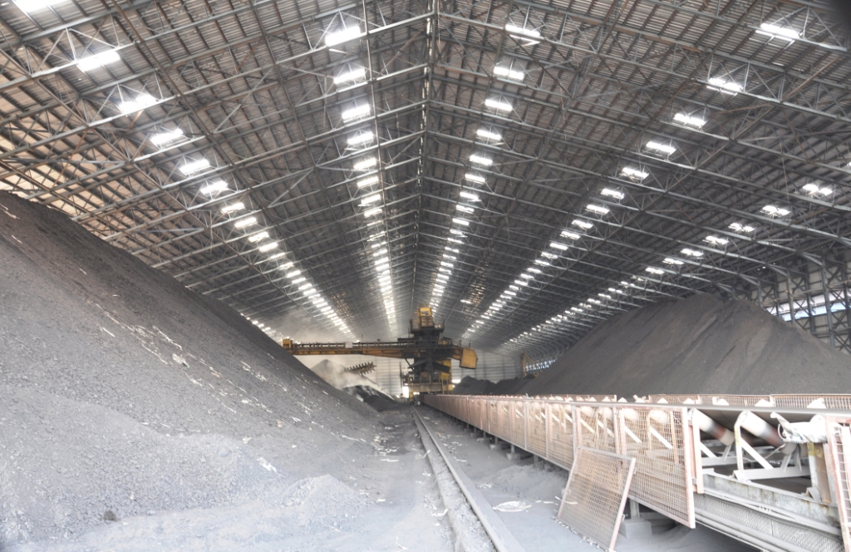
WHY STEEL BUILDINGS?
HIGH STRENGTH TO WEIGHT RATIO:
The weight of the structure made of steel will be less resulting in less member sizes & foundations.
  UNIFORMITY IN STRENGTH:
  Properties of steel do not change as opposed to concrete.

Slide 9
WHY STEEL BUILDINGS?
DUCTILITY
Steel can withstand extensive deformation without failure under high reversal of stresses especially in the case of earthquakes.
  TOUGHNESS
Steel has both strength and ductility.
  ADDITIONS TO EXISTING STRUCTURES
New bays or entire new wings can be added to existing frame buildings, and steel bridges may easily be widened.

Slide 10
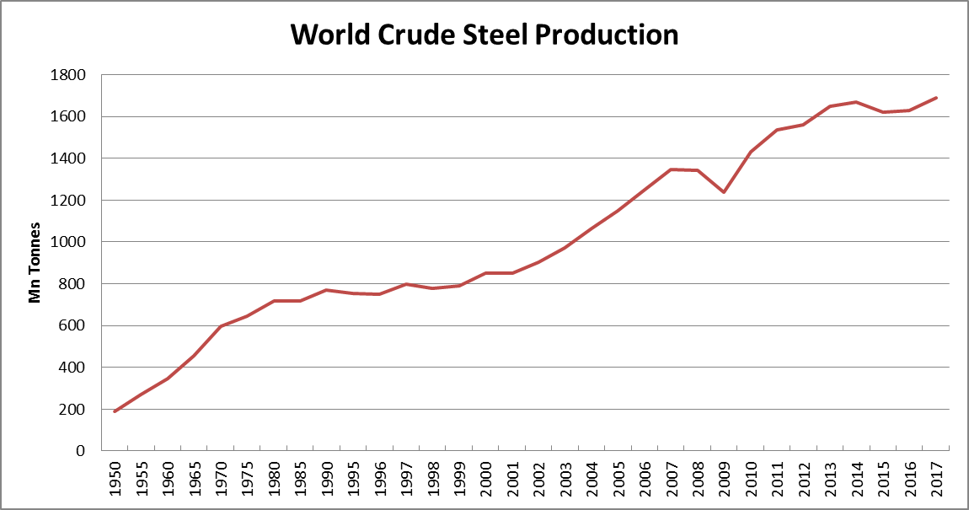
WORLD CRUDE STEEL PRODUCTION (1950 – 2017)
Year | Million Tonnes (MT)
1950 | 189
1955 | 270
1960 | 347
1965 | 456
1970 | 595
1975 | 644
1980 | 717
1985 | 719
1990 | 770
1995 | 753
1996 | 751
Year | Million Tonnes (MT)
1997 | 800
1998 | 779
1999 | 790
2000 | 850
2001 | 852
2002 | 905
2003 | 971
2004 | 1063
2005 | 1148
2006 | 1250
Year | Million Tonnes (MT)
2007 | 1348
2008 | 1343
2009 | 1239
2010 | 1433
2011 | 1538
2012 | 1560
2013 | 1650
2014 | 1670
2015 | 1621
2016 | 1627
2017 | 1689

Slide 11
APPARENT STEEL USAGE PER CAPITA 2009 TO 2017
Kilograms finished steel products

Slide 12
APPARENT STEEL USAGE PER CAPITA 2017
Kilograms finished steel products - 2017

Slide 13
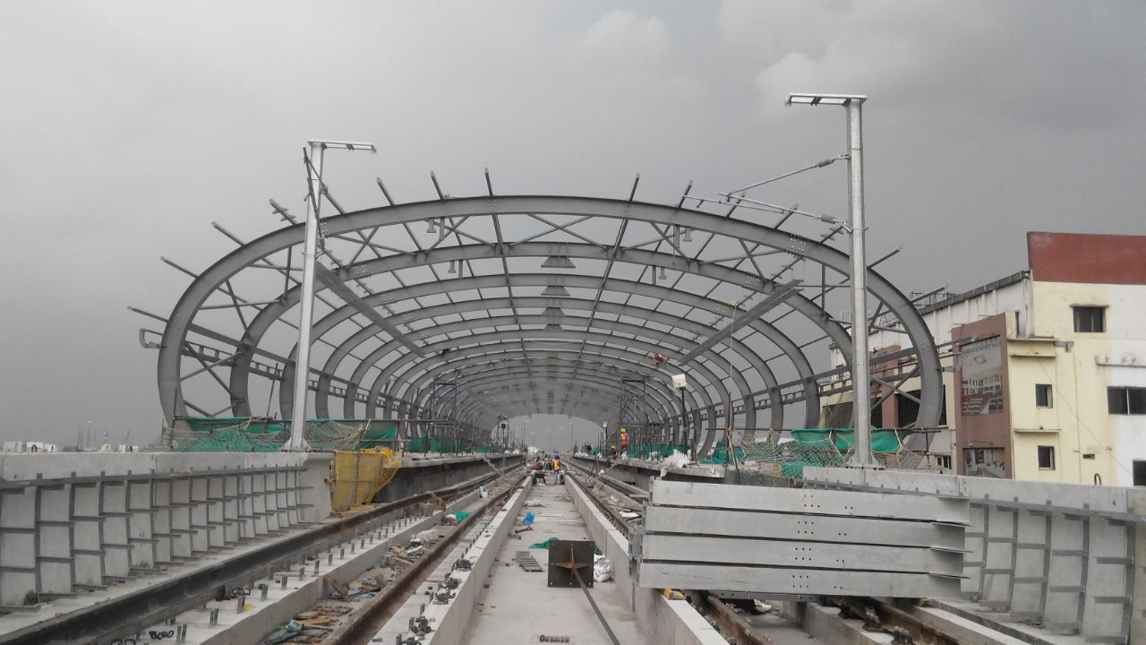
ADVANTAGES OF PEB
1) Ability to span long distance:
  Steel is good for clear/longer span. With steel, providing column less space is much economical than RCC
2) Faster occupancy:
  With PEBs, we can save 20-25% time in construction for industrial buildings & around 40% for multistoried buildings. Early occupancy generates early returns.
3) Cost efficiency:
  Optimized design results in less usage of steel and cost
4) Flexibility of expansion:
  PEBs are easy to expand or modify in future

Slide 14
ADVANTAGES OF PEB
5) Low maintenance:
  PEBs need very minimal maintenance
6) Earthquake & Hurricane resistant:
  PEBs are designed to take care of earthquake/hurricane impact
7) Single-source responsibility:
  In PEBs, responsibility starting from design till erection lies in single hand, hence no hassle of multiple agencies
8) Factory controlled Quality:
  From raw material till finish, at every stage, quality is been controlled thoroughly
9) Re-locatable:
  PEB buildings can be dismantled and re erected at other locations

Slide 15
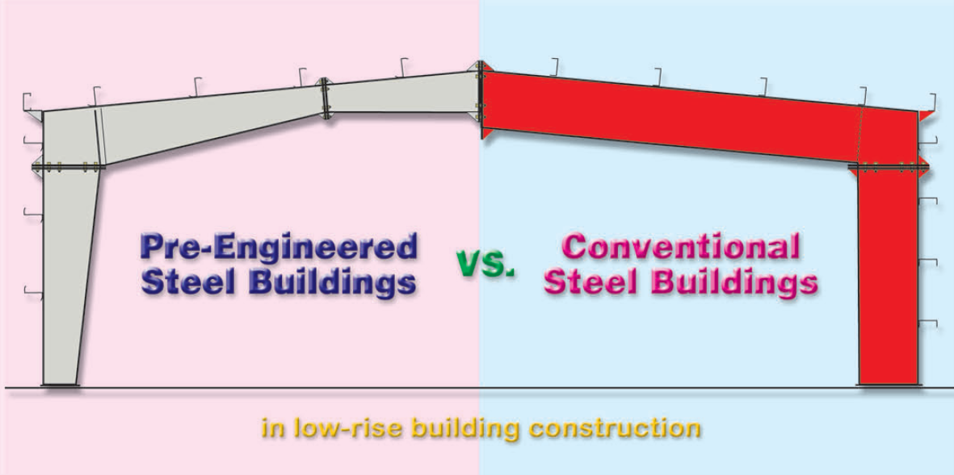
PEB V/S CONVENTIONAL

Slide 16
PEB V/S CONVENTIONAL
 | PEB | CONVENTIONAL
Quality | Factory controlled quality | Difficult to assure the quality due site fabrication
Foundations | Simple design, easy to construct and light weight | Extensive, heavy foundations required
Erection Cost & Time | Both costs & time of erection are minimized | Typically, they are 20% more expensive than PEB, Site welding may consume more time.
Architecture | Outstanding architectural design can be achieved at low cost | Special architectural design & features must be developed for each project
Future Expansion | Easy to expand for future requirements | Difficult to expand
Structure Weight | Pre-engineered buildings are on the average 30% lighter | Heavier than what is actually required
Responsibility | Single source for Design, Supply & Erection | Multiple agencies and difficulties in coordination

Slide 17
COMPARISON OF INDIAN CODE VS AMERICAN
 | INDIAN CODES | AMERICAN CODES
Year of Release | IS 800-2007 Steel design IS 801-1975 Cold form design IS 875-1987 For loads | AISC – 2010 AISI -2013 MBMA -2012, ASCE-2010
Design Methodology | Limit state Design Working Stress Method | Load Resistance Factored Design(LRFD) Allowable Strength Design
Compression design: Limiting d/t , b/t | Effective cross section area considered if limiting values are exceeding. | Effective stresses are calculated if limiting values are exceeding.
Flexural strength | Exceeding limiting values for slender section web is totally ignored | Exceeding limiting values for slender section stresses are reduced accordingly
Load combinations | Conservative | More rational

Slide 18
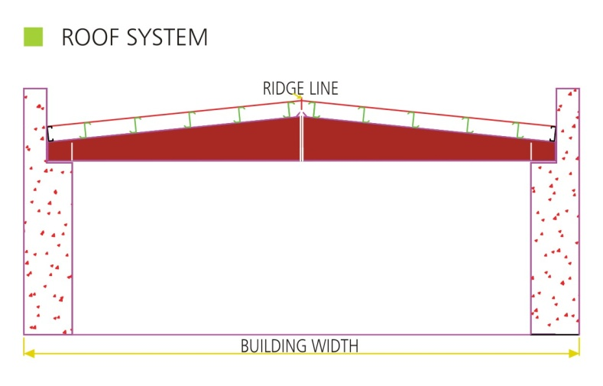
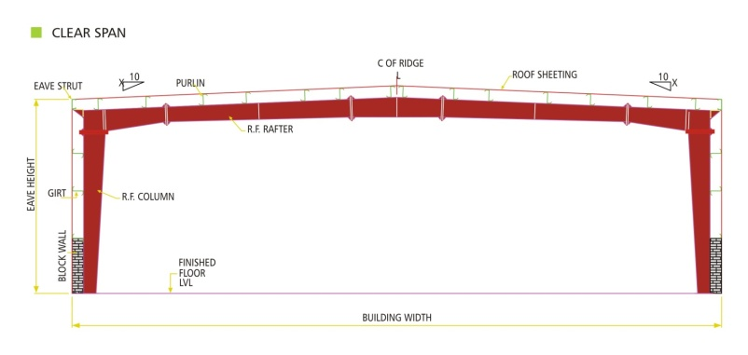
ROOF SYSTEM RAFTER VS PEB FRAME

Slide 19
DESIGN CODES & FRAME COST - A COMPARISON
Weight of the frames for the case of different eave heights are compared, using US Code as well as Indian codes.
The use of Indian codes, being more stringent , result in more than 10% heavier frames
A wise blend of adequate design strength and at same time, economy in construction cost , may be the best option.
American

Slide 20
ADVANTAGES OF PEB
DESIGN CODES
There is a cost implication to the choice you make regarding the codes to be followed for a building
Buildings can be offered as per American codes , Indian codes or any other International code
American codes , due to the incessant research-based up-gradations, are the most technically advanced. They offer the best blend of design strength and low product cost
It is recommend to use wind & seismic application as per Indian codes, IS 875, 1893 and Design & other consideration as per American codes, AISC,MBMA, AWS
Latest editions of all the codes are always to be followed.

Slide 21
ADVANTAGES OF PEB
Disadvantages of Pre-Engineered Steel Buildings
Additions to PEB’s in future to accommodate growth are difficult unless the future expansion requirements are given initially itself while designing.
If not properly maintained, the steel frames are susceptible to corrosion, thus special coatings become necessary to resist corrosion.
During fire, this type of building becomes more susceptible to damage due to it’s conductivity.
Steel being good at conducting steel, it reduces the thermal comfort in the building.
If proper procedures are not followed, the building may collapse during erection.

Slide 22
GREEN BUILDINGS
A GREEN BUILDING has characteristics that reduce its environmental impact during its life cycle – from construction all the way through to the end of the building’s useful life. These green building characteristics are measured against three criteria.
ENVIRONMENTAL: The impact the building will have today and in the future when considering factors as energy usage, efficient use of space, recyclability, materials used for construction, all in an effort to conserve natural resources
ECONOMIC: Lowering operating costs, enhancing asset value, improving productivity, as well as optimizing lifecycle performance
HEALTH & COMMUNITY: Improvement of air quality, occupant comfort, and overall health conditions

Slide 23

GREEN BUILDING STANDARDS
Site Selection & Planning
Water Conservation
Energy Conservation
Material Conservation
Indoor Environment Quality
Innovation in Design

Slide 24
Steel Buildings Environmentally-Friendly Structures
Steel Buildings Produce Lower Construction Waste Steel structures are pre-engineered and created with the purpose of shorter construction timeframes and less waste. Steel is one of the most recyclable building materials (at 98%). The recyclable capabilities of the material make steel one of the most environmentally-friendly building materials used today. 2. Metal Buildings Reduce Overall Energy Costs Using sky lights and proper ventilation, day time lighting is not required, hence energy cost is less. By using insulation, thermal comfort can be achieved.

Slide 25
Steel Buildings Environmentally-Friendly Structures
3. Solar Power Options Are Easy to Add-on Solar panels on roof top would help to reduce energy bill because of creating own energy. 4. Steel Buildings Last For A Long Time Steel buildings are eco-friendly structures that require the least amount of renovations or lifetime maintenance. Pre-engineered steel buildings are designed to withstand a wide variety of natural elements such as high winds, earthquakes, heavy snow, rainfall, and more.

Slide 26
Steel Buildings Environmentally-Friendly Structures
5. Steel Buildings Meet “Green Building: Standards and Codes Steel buildings have grown in popularity because of their ability to meet the green building codes and sustainability standards. This material meets the requirements for the country's leading green construction agencies: LEED (Leadership in Energy and Environmental Design) program by the US Green Building Council and the National Green Building Program.

Slide 27
CLEAR SPAN BUILDINGS

Slide 28
Large Clear Span Steel Buildings
Aircraft hangars
Churches
Equestrian indoor riding arenas
Gymnasiums
Indoor pools
Indoor sports facilities
Indoor tennis courts
Large manufacturing plants
Large truck or farm equipment shelters
School auditoriums
Skating rinks
Theaters
Warehouses
Coal and Gypsum storage sheds in cement plants

Slide 29
Design Loads consideration
Loads consideration for design , depending on functional use of structure.
Dead ( self wt. sheeting , dust load, wind load etc.)
Roof slope are very important controlling the deflection, economical design.
Bay spacing depends on Load , Wind pressure
Internal pressure coefficient should be properly calculated, frame design economy depends on it.
Bracing system should be provided for both top & bottom member of rafter & column.
Lateral & Longitudinal stability system should be provided.

Slide 30
Design Consideration (Built-up Section)
Large span more than 60M to 120M built up section are economical i.e. two leg, three leg , four leg.
Built up section are Tube section , channel section , Angle section.
Three leg , four leg section stable are suitable for lager span
more than 80M.
Staad 3D modelling is economical space frame as compared to 2D modelling
Frame connection are economical i.e member are subjected to axial force with nominal moment.
Pinned base plate & foundation are economical due to built-up sections.

Slide 31
99m Clear Span Building at Ultratech – Kotputli, Rajasthan

Slide 32
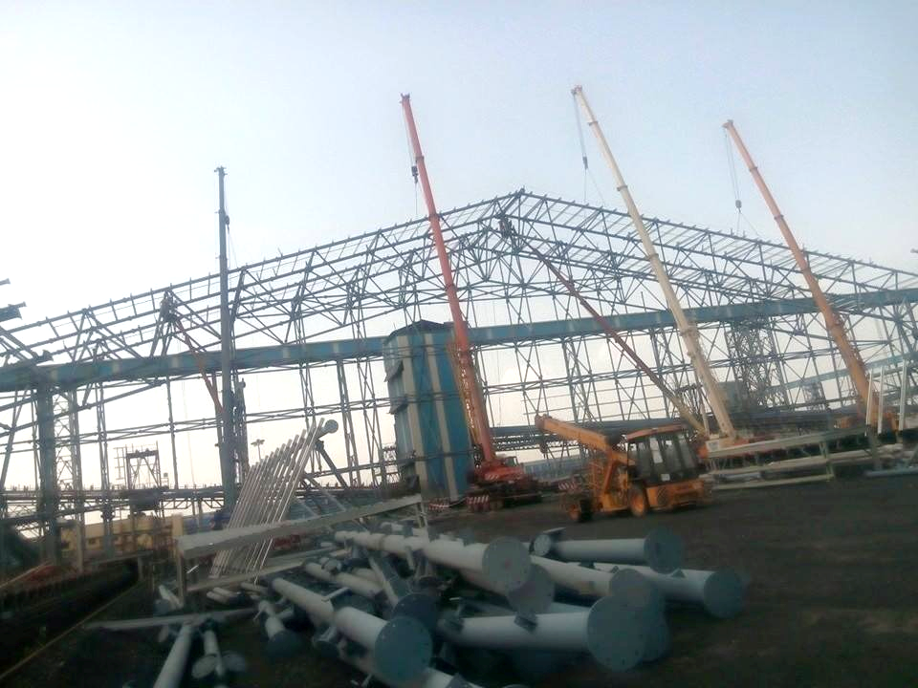
Installation of 99m Clear Span Building
Notes:
Installation of 99m Clear Span Building

Slide 33
65m Clear Span Building at My Home Cements, Telangana
Notes:
65m Clear Span Building

Slide 34
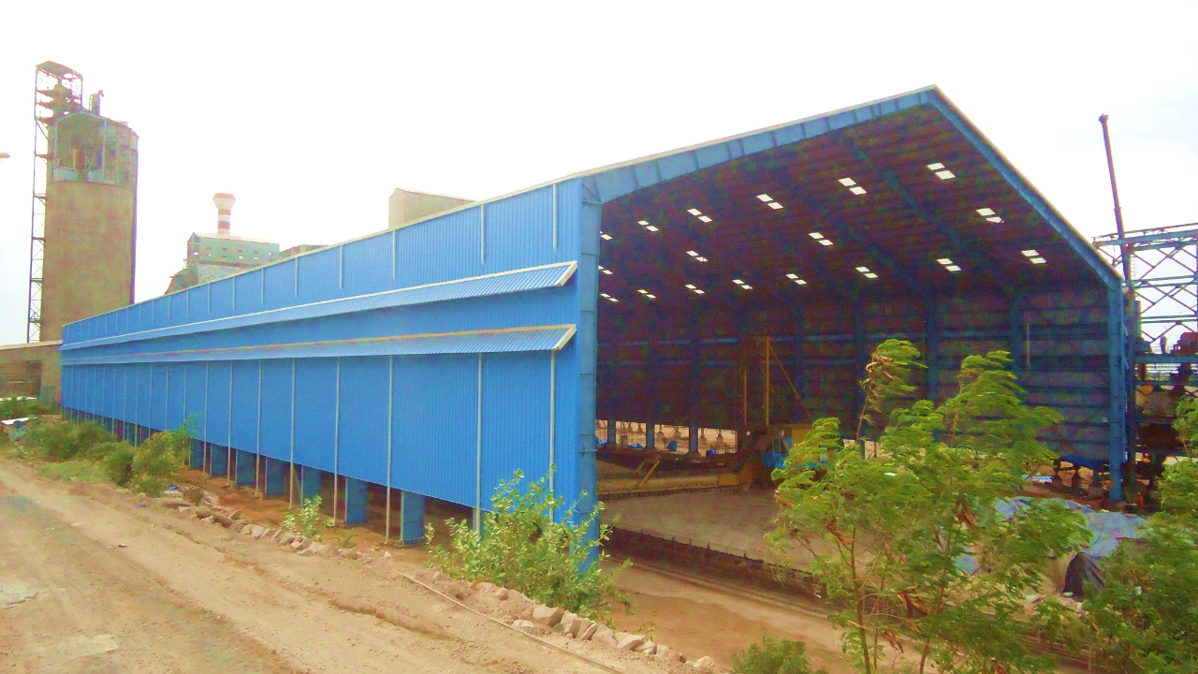
70m Clear Span Building at Ultratech, Madhya Pradesh

Slide 35
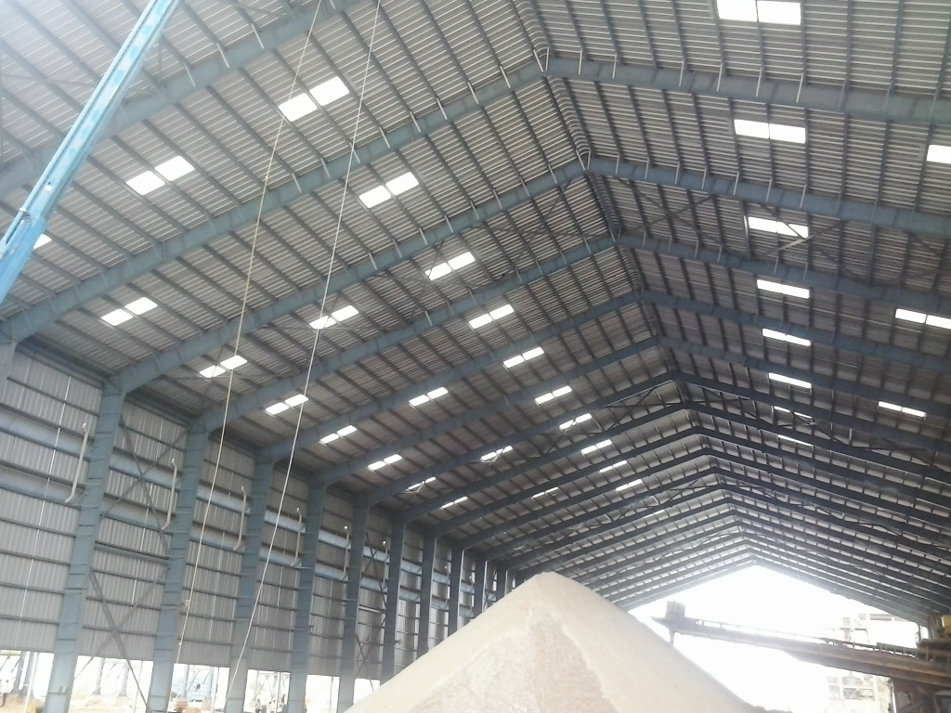
Advantages

Slide 36
Advantages of PEB for Clear Span Structures
Steel consumption can be optimized in PEB as compared to conventional structures (approx. - 25%)
Structure can be designed with open and solid-web, based on span of the structure
Can be designed to reduce installation complexity
Easy to install compared to conventional structures
Can be constructed faster than conventional structure because all the connections are bolted

Slide 37
THANK YOU

